Slide 1
Netfield

Slide 2
Members:
Kshitij Parag Ukey (22BCY10139)
Ansh Garg (22BCY10178)
Khushi Kumari (22BCY10275)
Kashinath R. (22BCY10094)
Nupur Shivani (22BCY10066)

Slide 3
Contents Covered
Introduction
Existing work w/ Limitations
Proposed work & Methodology
Novelty of project
Real time usage
Hardware and Software Requirements
Overall System Architecture
Literature Review
Module Description
Module Work Flow Explanation
Implementation & Coding
Demo Video
Snapshots
Testing
Results
Conclusion

Slide 4

Introduction
We created network packet analyzer. It allows you to capture and analyze network packets in real-time, making it a valuable tool for network monitoring and debugging.
It's particularly useful for diagnosing network issues, monitoring traffic, and gaining a deeper understanding of network behavior.

Slide 5
Existing tools and their limitations
Wireshark:
Limitations:
Wireshark can be resource-intensive, especially when capturing a large volume of packets, making it unsuitable for high-speed networks.
The GUI may not be as user-friendly for beginners, and some features may require a learning curve.
Limited support for real-time monitoring, as it is primarily designed for packet analysis after the capture
tcpdump:
Limitations:
It lacks a graphical user interface, which can be challenging for non-technical users.
Tcpdump may not provide as extensive protocol analysis features as some GUI-based tools.
Understanding the command-line options and filters may require network expertise

Slide 6
Proposed Work
The proposed work is a code of packet capture and analysis with a graphical user interface (GUI) using PyShark and tkinter. It will be allowing users to capture and analyze network packets in real-time. It is different from tools like Wireshark and tcpdump in the following ways:
1. User Interface -
- The project will have a graphical user interface (GUI) created using Tkinter, which allows users to interact with the application using buttons, text fields, and a tree view. Wireshark and tcpdump, on the other hand, are command-line tools without a graphical interface.
2. Ease of Use -
- The code will be user-friendly and suitable for individuals who may not be comfortable with command-line tools. In contrast, Wireshark and tcpdump require users to have a certain level of expertise in working with command-line parameters.
3. Real-Time Capture:
- The code will be offering real-time packet capture and analysis. Users can start and stop packet capture at their convenience. Wireshark can also perform real-time capture, but tcpdump is primarily designed for static capture and post-capture analysis.

Slide 7
4. Packet Analysis -
- The project will analyze network packets features that will allow users to view and inspect packet details in a structured format. Wireshark is a specialized packet analyzer that provides extensive capabilities for packet inspection and filtering.
5. Scriptability -
- The code will be written in Python, making it scriptable and customizable. Users can extend its functionality or integrate it with other Python applications. Wireshark and tcpdump are standalone tools with limited scripting capabilities.
6. Limited Features -
- The code offers basic packet capture and display features. It lacks the advanced filtering, protocol decoding, and analysis capabilities provided by Wireshark. Wireshark, in particular, is a comprehensive packet analysis tool used for in-depth network troubleshooting and analysis.
7. Dependency -
- The provided code depends on external Python libraries like PyShark, tkinter, and tabulate. In contrast, Wireshark and tcpdump are standalone applications that don't rely on additional Python libraries.
8. Cross Platform Compatibility -
- While Wireshark and tcpdump are available for various platforms, the code's cross-platform compatibility may depend on the availability of the required Python libraries and modules.

Slide 8
Methodology
Import the Necessary Libraries:
‘PyShark’ for capturing and analyzing the network packets.
‘time’ for timing purpose.
‘tkinter’ for creating a GUI.
‘message box’ from ‘tkinter’ for displaying error or information messages.
‘ScrolledText’ from ‘tkinter’ for creating a scrollable text box.
‘ttk’ from ‘tkinter’ for creating a treeview widget.
‘tabulate’ for formatting captured packet data in a tabular format.
‘socket’ for getting the host’s IP Address.
‘Psutil’ provides system-related information, such as network interfaces.
‘logging’ to log packet details to a file.
‘Geoip2. database’ for IP address geolocation with GeoLite2City database.

Slide 9
2. Configure the logger:
Set up logging to log packet details to a file named "packet_capture.log.“
3. Create a GeoIP reader:
Initialize a GeoIP reader to look up geographic information for IP addresses using the GeoLite2 City database.
4. Define a global variable for dark mode.
5. Define the `analyze_packet` Function to analyze a captured packet:
- The `analyze_packet` function is defined to process and analyze each captured packet.
Extract relevant information from the packet, such as timestamp, protocol, packet length source and destination IP addresses of each packet.
Return the extracted information in the list.
6. Implement the ‘get_geo_location’ function:
This function uses the GeoIP reader to retrieve geographic information for an IP address.
7. Implement functions to retrieve network interface and IP addresses:
get_wifi_ip_address and get_eth_ip_address functions retrieve the IP addresses for Wi-Fi and Ethernet connections.
get_network_interfaces function returns a list of available network interfaces.

Slide 10
8. Define the function ‘packet_selected (event)’ to handle the selection of packet
in the packet ‘treeview’ :
Get the selected packet from the treeview.
Call ‘show_packet_details’ to display the details of the selected packet in a new window.
9. Define a function ‘show_packet_details(packet)’ to display the details of a selected packet:
Create a new window for displaying the packet details.
Extract and format the packet details, including time stamp, protocol, source IP, destination IP, and Packet length.
Retrieve and display the packet details in a scrolled text box.
10. Define a function ‘start_capture()’ to begin capturing the network packets:
Set the ‘capturing’ flag to ‘True’.
Get the Network Interface and capture filter from the user Input.
Attempt to start a Live Capture using ‘PyShark’.
Capture packets continuously and analyze them until ‘capturing’ is ‘False’.
Update the captured data display using ‘show_captured_data’.

Slide 11
11. Define a function ‘stop_capture()’ to stop the packet capture:
Set the ‘capturing’ flag to ‘False’ .
12. Define a function ‘referesh_data()’ to refresh the captured data:
Check if packet capture is still running; if so, display an error message.
If not, clear the displayed data and reset the Wi-Fi IP address Label Create Global Variables:
‘capturing’ to track whether packet capture is running.
‘capture_duration’ to store the specified capture duration.
13 .Create the main application window (‘root’) using tkinter and configure its appearance and size.
Create and configure GUI elements:
Label for displaying information.
Entry fields for a user input.
Buttons for starting, stopping, and refreshing the data capture.
A scrolled text box for displaying the captured packet data.
Scrollbars for scrolling through the text box.
A treeview widget for displaying a summary of captured packets.
14.Setup the GUI loop using ‘root.mainloop()’ to launch the application.

Slide 12
Novelty of the project
Netfield brings several novel features and capabilities to the field of network monitoring and analysis:
User-Friendly GUI: Many existing packet capture tools are command-line based, which can be intimidating for non-technical users. The novel aspect of this project is its graphical user interface (GUI), making it accessible to a wider range of users, including network administrators, security analysts, and IT professionals.
Geographic Location Resolution: The tool integrates the GeoIP database to resolve IP addresses to geographic locations. This feature provides a unique perspective on network traffic by allowing users to see where data is coming from and going to. This can be valuable for identifying potential security threats or understanding global network patterns.
Layered Packet Analysis: The tool offers a detailed view of network packets, allowing users to inspect each layer of a packet. This feature is especially beneficial for network analysts who need to dig deep into packet headers to troubleshoot issues.
Real-Time Packet Capture and Analysis: While many packet capture tools can capture packets in real-time, this tool takes it a step further by providing the capability to analyze the packets in real-time. This allows users to quickly identify issues or anomalies as they occur.

Slide 13
Real time usage
Netfield can be used in various real-time scenarios for monitoring and analyzing network traffic. Here are some practical real-time usage scenarios for the code:
Network Troubleshooting: Use the tool to capture and analyze packets on a specific network interface to troubleshoot connectivity issues, latency problems, or packet loss in real-time. Analyze the captured packets to identify network anomalies.
Security Monitoring: Monitor network traffic in real-time to detect and investigate potential security threats or intrusions. The tool can help security analysts identify unusual or suspicious traffic patterns.
Performance Monitoring: Continuously capture and analyze network packets to monitor the performance of network applications and services. Identify bottlenecks and network congestion in real-time.
Network Protocol Analysis: Use the tool to examine the behavior of specific network protocols in real-time. Identify protocol-related issues or misconfigurations as they occur.
Real-Time Visualization:Display network traffic in real-time, providing a visual representation of the data flow. This can be valuable for monitoring the overall health of a network and spotting trends as they happen.

Slide 14
Hardware & Software Requirements
We will need some of the libraries specially like pcap , pyshark , tkinter , psutil , geoip2 .
We can do this by typing the command in the terminal of VS Code by typing “ pip install ____ ” . This command will install the libraries from the internet .
We will also need a pcap module from the internet .
Python 3.11 is a necessary tool for running the software and GUI .
VS Code is also necessary for running the code .
And in the code section in line 23 for geoip_reader .
For Hardware , Minimum Intel i5 7th Gen Processor , 4GB Ram and atleast 1GB of Storage .

Slide 15
System Architecture Diagram
START
Input Network Interface
Input Capture Filter (tcp , udp)
Input the time limit for network packets capture

Slide 16
Analyze Packet Function
Extract packet data
Return packet data
Exception handling for invalid packets
Get Wi-Fi IP Address Function | - Get the hostname | - Get the IP address of the host | - Handle socket errors
Packet Selected Function | - Handle the selection of a packet in the list | - Extract the packet and display details
Show Packet Details Function | - Create a new window for packet inspection | - Display packet details in a text area

Slide 17
Start Capture Function | - Initialize packet capture | - Continuously capture packets | - Analyze and store captured data | - Update the display with new packets | - Handle exceptions related to capture |
Clear and reset captured data and UI | | - Show "Stop the capture" message if running
Show Captured Data Function | - Get the Wi-Fi IP address | - Format captured data into a table | - Display data in the ScrolledText widget
Get the location of the Source IP and Destination IP using geoip2 module | - Show the location in the Interface
If Refresh is clicked
After completing the time limit
Main Window (Root) | | - Create the main application window | | - Add UI elements (labels, buttons, etc.) | | - Initialize ScrolledText and Treeview
Else
Stop

Slide 18
Literature Review
Introduction
Network packet capture and analysis are fundamental tasks in the field of network management, monitoring, and security. The ability to capture, inspect, and understand network traffic is essential for maintaining the stability, security, and performance of modern computer networks. Netfield provides a valuable solution for these tasks, featuring a user-friendly GUI and real-time packet analysis capabilities.
Existing Work in Packet Capture and Analysis
Wireshark:
Wireshark, one of the most well-known packet capture tools, is an essential reference in the field. It offers a comprehensive feature set for capturing and analyzing network packets. Wireshark’s strength lies in its support for numerous protocols and its powerful analysis capabilities. However, it is primarily a post-capture analysis tool and may not provide real-time analysis to the same extent as the project.
tcpdump and Tshark:
Tcpdump and its command-line counterpart, Tshark, are known for their efficiency in capturing network packets on Unix-like systems. While they are lightweight and scriptable, they lack a GUI and the extensive protocol analysis capabilities that a tool like Wireshark offers.

Slide 19
Literature review (contd)
Challenges and Opportunities
While the existing tools mentioned above provide valuable solutions for network packet capture and analysis, they come with certain limitations. Many are resource-intensive and may not be as accessible to non-technical users. The project seeks to address some of these limitations by offering a user-friendly GUI and real-time analysis capabilities. However, it's important to consider the following challenges and opportunities for improvement:
Resource Efficiency: A critical challenge in packet capture and analysis is resource consumption. For real-time analysis, it's essential to optimize resource usage to ensure minimal impact on network performance.
Usability: Usability and user-friendliness are important factors, especially for users who may not have an in-depth understanding of networking. Enhancing the project's user interface and documentation could improve its accessibility.
Customization: The ability to customize capture filters and analysis options can provide greater flexibility for users with specific network monitoring needs.

Slide 20
Module Description
PyShark is a Python module that provides a convenient and user-friendly way to work with packet capture files, such as those in the popular PCAP (Packet Capture) format. It acts as a wrapper around the Wireshark command-line tool, allowing you to programmatically analyze and extract information from network packet captures.
time module provides various functions to work with time, including time measurement, manipulation, and formatting. It's commonly used for adding delays, measuring execution time, and formatting timestamps.
tkinter is the standard Python interface to the Tk GUI toolkit. It allows you to create graphical user interfaces for desktop applications. You can build windows, dialogs, buttons, and other GUI components.
tabulate module simplifies the process of creating formatted tables from data in Python. It's useful for presenting data in a structured and readable way, often in text-based applications or reports.
socket module provides a low-level interface for network communication. It allows Python programs to create, send, and receive data over network connections, making it essential for network programming.
psutil is a cross-platform library for retrieving information on system utilization and management. It can be used to gather data on processes, system resources, and other system-related information.
logging module in Python is used for creating log files and handling log messages in your applications. It offers flexibility in logging levels, formatting, and output destinations for debugging and monitoring.
geoip2 is a library for working with GeoIP (geographical location) data. It enables you to look up the geographical location, such as country, city, or latitude/longitude, of an IP address.
threading module provides a high-level, multi-threading API in Python. It allows you to create and manage threads for concurrent execution, which is useful for tasks that can run in parallel to improve performance.

Slide 21
Module Work Flow Explanation
A workflow explanation of the project and the role of each module in that workflow:
1. Initialization -
- The code begins by importing the necessary Python modules.
- The `logging` module is configured to create log files for recording packet details and errors.
2. GeoIP Database Initialization -
- The `geoip2` module is used to initialize a GeoIP database, which is then used to perform geographic location lookups for IP addresses in captured packets.
3. GUI Setup with tkinter -
- The `tkinter` module is used to set up the graphical user interface (GUI) for the application.
- Labels, dropdown menus, buttons, and text areas are created to allow user interaction.
4. Packet Capture Configuration -
- The user can select a network interface and a capture filter using the GUI.
- The selected interface is used to capture network packets in real-time using the `pyshark` module.
- The `capture_filter` helps filter the packets based on specified criteria (e.g., protocol, port, host).
5. Packet Capture (start_capture Function) -
- When the "Start Capture" button is clicked, the `start_capture` function is called.
- The `pyshark` module captures packets from the selected network interface according to the specified filter.
- Packet details are analyzed using the `analyze_packet` function, and captured data is updated in real-time in the GUI.

Slide 22
Module Work Flow Explanation
6. Packet Analysis (analyze_packet Function) -
- The `analyze_packet` function processes and analyzes each captured packet.
- It extracts details such as timestamp, protocol, source and destination IP addresses, and packet length.
- Geographic location information for source and destination IPs is obtained using the `geoip2` module.
- Packet details are logged using the `logging` module.
7. Packet Display (show_captured_data Function) -
- The `show_captured_data` function updates the GUI with the captured packet data.
- It displays Wi-Fi and Ethernet IP addresses, and a tabular representation of packet details using the `tabulate` module.
8. Packet Selection (packet_selected Function) -
- When a packet is selected in the packet treeview, the `packet_selected` function is triggered.
- It displays detailed information about the selected packet in a new window.
9. Stop Capture (stop_capture Function) -
- The "Stop Capture" button calls the `stop_capture` function to stop packet capture.
- The capture process can also be stopped when the specified capture duration is reached.
10. Data Refresh (refresh_data Function) -
- The "Refresh Data" button calls the `refresh_data` function to clear captured data and update the GUI.
- This function is available when the capture process is not running.
11. Concurrent Execution with threading -
- The `threading` module is used to manage the packet capture process, ensuring that it can run concurrently with the GUI.
- This allows the application to capture packets in the background while remaining responsive to user actions.
12. User Interaction and GUI Output -
- The GUI provides user-friendly interaction for starting/stopping captures, selecting and viewing packets, and refreshing displayed data.

Slide 23
Implementation
Creating the code from the provided modules requires careful implementation of each component and functionality.
Implementations will be as ->
Ensuring you have the required Python modules installed, including pyshark, tkinter, tabulate, socket, psutil, logging, and the GeoIP2 library. You'll need a GeoIP database file as well.
Set up the logger configuration using logging.basicConfig to define the log form at and file.
Use the tkinter library to design and create the graphical user interface (GUI) for your application. You can use the provided code as a starting point.
Implement Network Interfaces:
Use the psutil library to get a list of available network interfaces. Populate a dropdown menu in the GUI with these interfaces.
Implement Capture Filters:
Define a list of capture filters (e.g., "tcp," "udp," etc.) that users can select from in the GUI. Populate a dropdown menu with these filters.
Implement GeoIP Database Reader:
Initialize the GeoIP2 database reader by providing the path to the GeoIP database file.

Slide 24
Implementation
6.Implement Packet Analysis:
Write a function for packet analysis. This function should take a packet as input, extract relevant information (timestamp, protocol, source and destination IPs, length), and perform GeoIP lookups. Use try-except blocks to handle exceptions gracefully.
7.Implement Real-time Packet Capture:
Write functions to start and stop packet capture using pyshark's LiveCapture. Ensure you capture packets using the selected network interface and capture filter. Analyze each captured packet using the analyze_packet function.
8.Implement GUI Functions:
Implement functions that update the GUI elements in real-time. For example, update the captured data in a text box, update IP addresses, and handle button actions (Start, Stop, Refresh).
9.Implement Packet Selection and Details:
Write functions that allow users to select a packet from the list and view its details in a separate window. Populate this window with packet information, including protocol details.
10.Implement Packet Selection and Details:
Write functions that allow users to select a packet from the list and view its details in a separate window. Populate this window with packet information, including protocol details.
11.Implement Error Handling:
Add error handling to deal with potential exceptions in the code, such as network interface unavailability or issues with the GeoIP database.

Slide 25
Coding
1. Import necessary libraries (pyshark, time, tkinter, etc.).
2. Define a function `analyze_packet(packet)` to extract and analyze information from a captured packet.
3. Define a function `get_wifi_ip_address()` to get the Wi-Fi IP address of the host.
4. Define a function `packet_selected(event)` to display details of a selected packet.
5. Define a function `show_packet_details(packet)` to open a new window and display detailed information about a packet.
6. Define a function `start_capture()` to start capturing network packets based on user input.
7. Define a function `show_captured_data(data)` to display captured packet data in the GUI.
8. Define a function `stop_capture()` to stop the packet capture.
9. Define a function `refresh_data()` to clear and refresh the captured data.
10. Define a function `toggle_dark_mode()` to switch between light and dark modes for the GUI.
11. Initialize global variables `capturing` and `capture_duration`.
12. Create a Tkinter window (root) for the GUI.
13. Set the title, size, and background color of the root window.

Slide 26
3
14. Create GUI elements:
- Label for displaying Wi-Fi IP address.
- Text entry for specifying the network interface.
- Text entry for specifying the capture filter.
- Text entry for specifying the capture duration.
- Buttons for starting, stopping, and refreshing the capture.
- ScrolledText widget for displaying captured data.
- Scrollbars for the ScrolledText.
- Treeview widget for displaying a list of captured packets.
- Button for toggling dark mode.
15. Configure the visual appearance (colors) of the GUI elements.
16. Set event handlers for the buttons:
- Start Capture: Calls `start_capture()`.
- Stop Capture: Calls `stop_capture()`.
- Refresh Data: Calls `refresh_data()`.
- Toggle Dark Mode: Calls `toggle_dark_mode()`.

Slide 27
17. Create the main event loop with `root.mainloop()` to run the GUI application.
18. In the `start_capture()` function, capture packets continuously, analyze them, and update the display until the capture is stopped or the specified duration is reached.
19. In the `show_captured_data(data)` function, update the display with the captured packet data and refresh the Treeview widget.
20. In the `stop_capture()` function, set the `capturing` flag to stop packet capture.
21. In the `refresh_data()` function, clear the displayed data and reset the Wi-Fi IP address.
22. In the `toggle_dark_mode()` function, change the color scheme of the GUI to switch between light and dark modes.
The provided pseudo code summarizes the main functionalities of the script and the structure of the GUI application. The actual Python code provides the implementation details for each function and element.

Slide 28
Demo Video

Slide 29
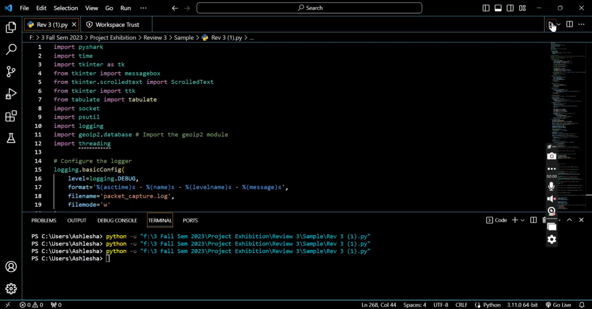
Please single click the below image and press play button to play the video

Slide 30
Snapshots

Slide 31
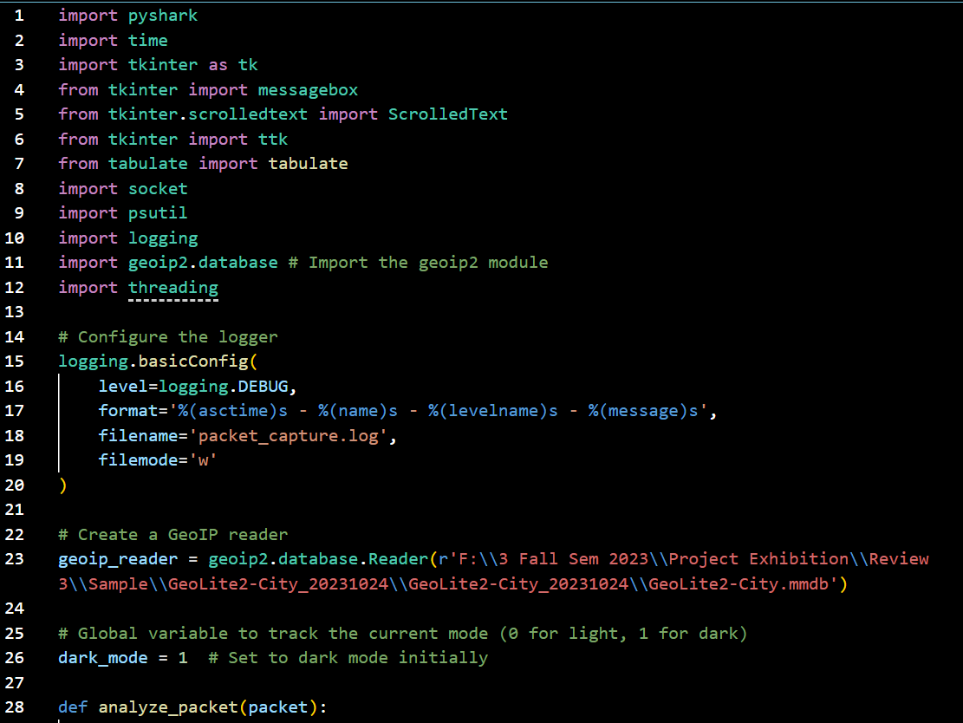

Slide 32
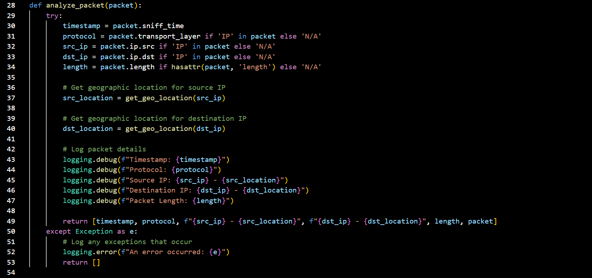

Slide 33
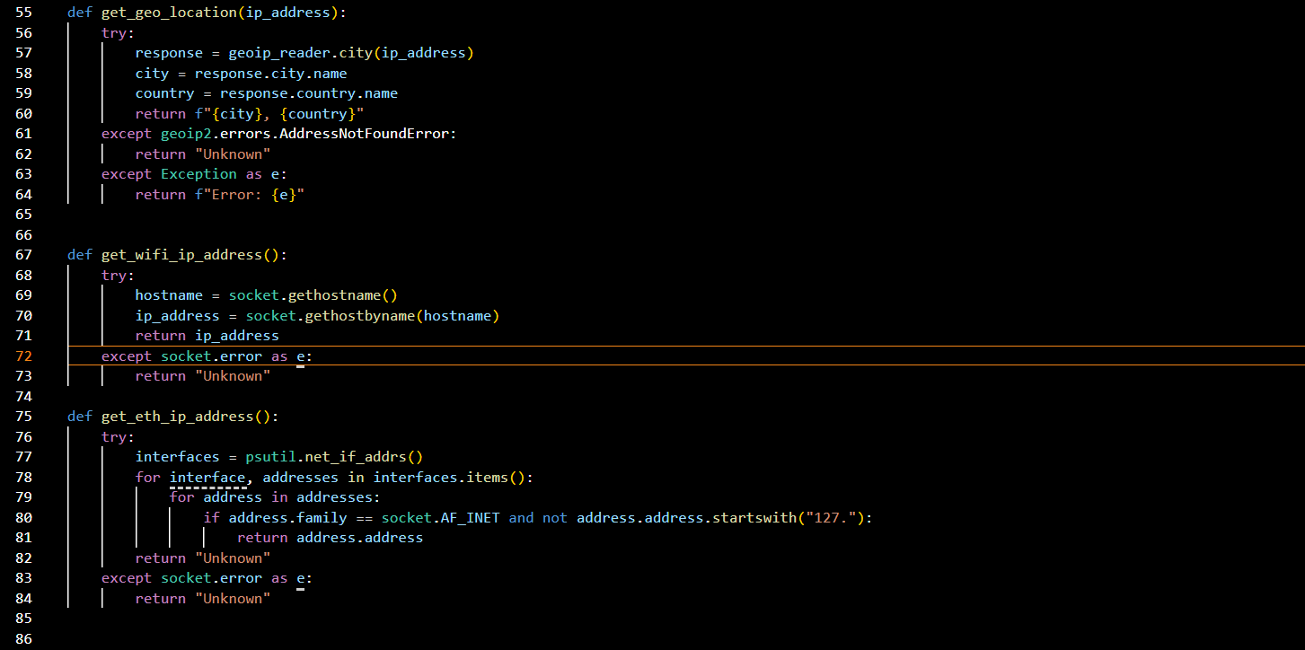

Slide 34
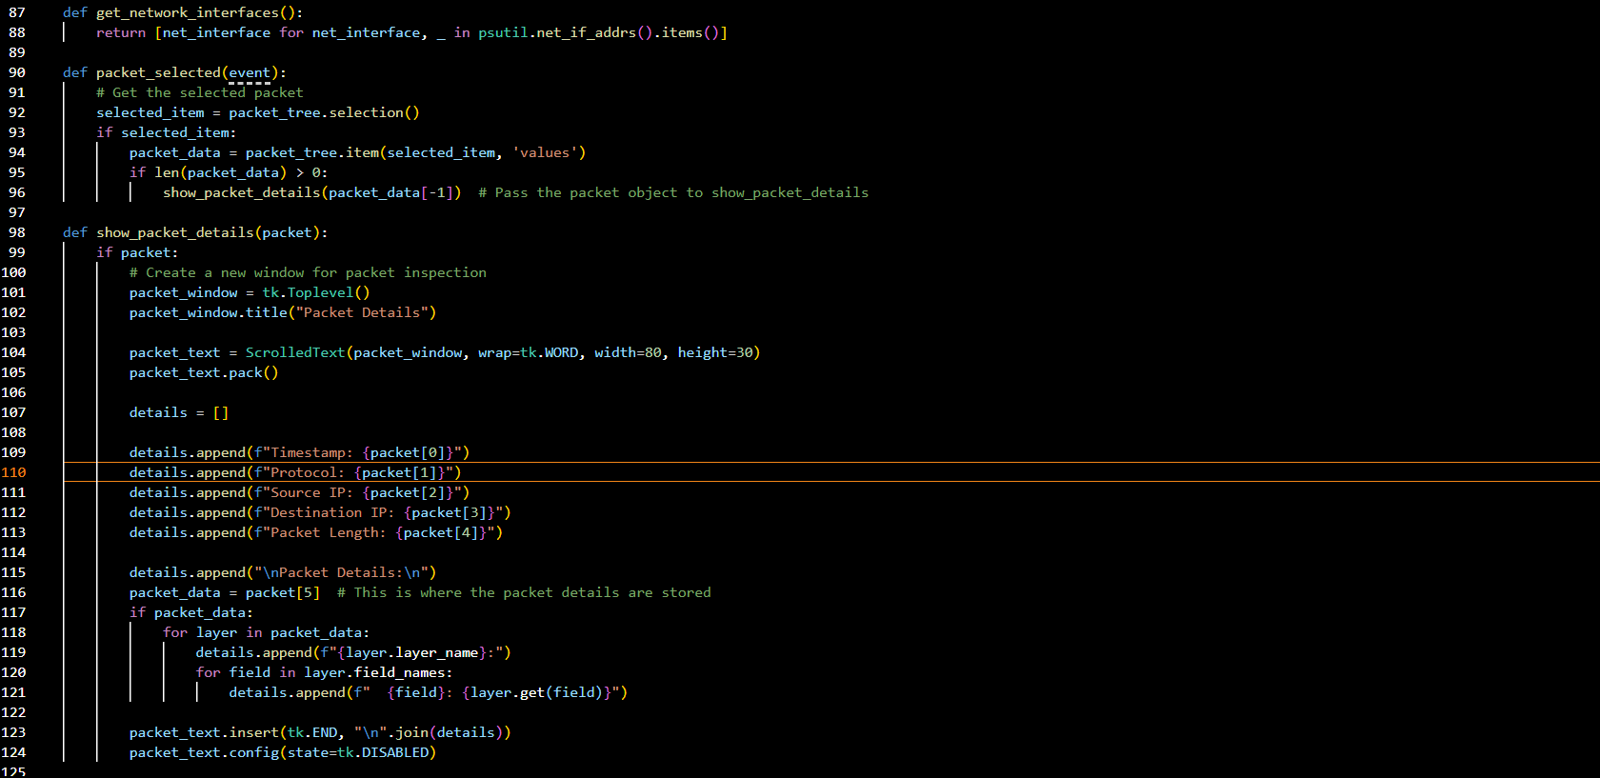

Slide 35
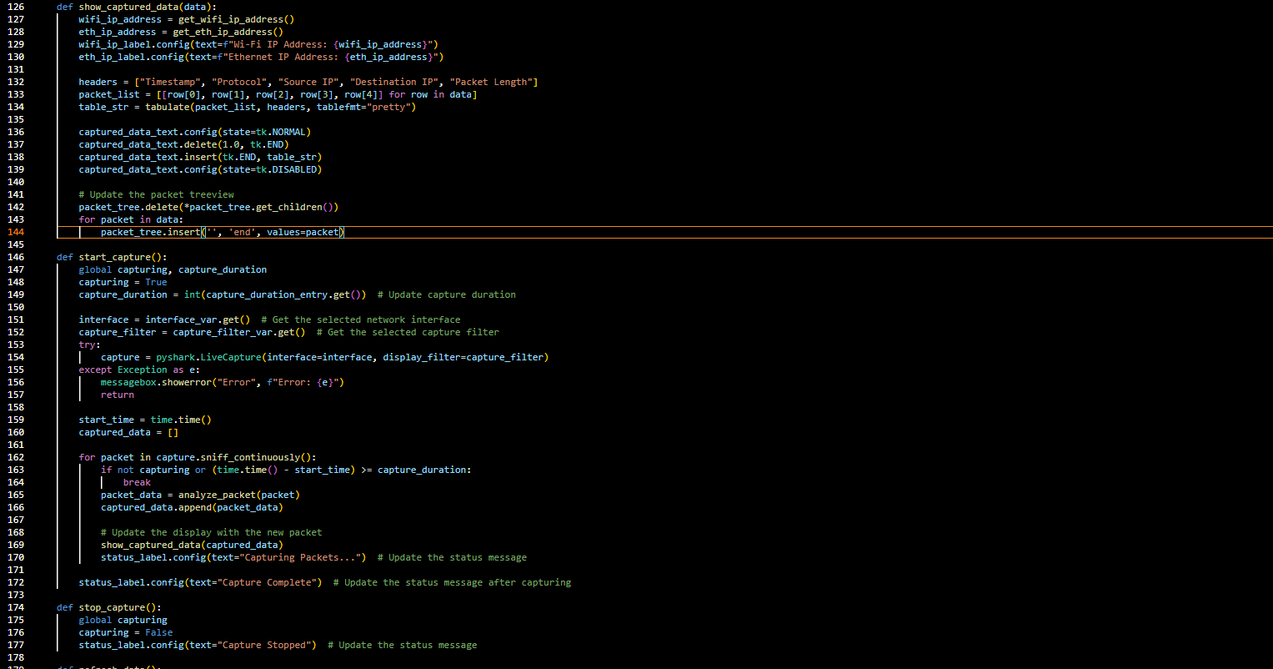

Slide 36
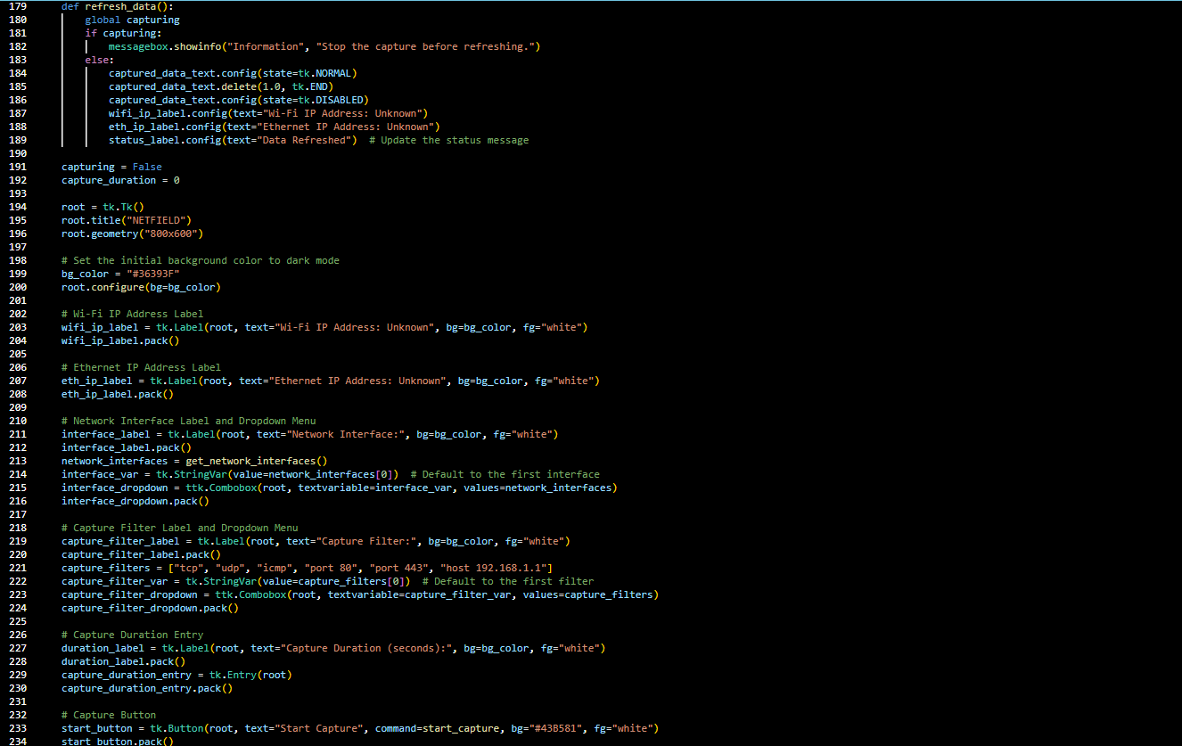

Slide 37
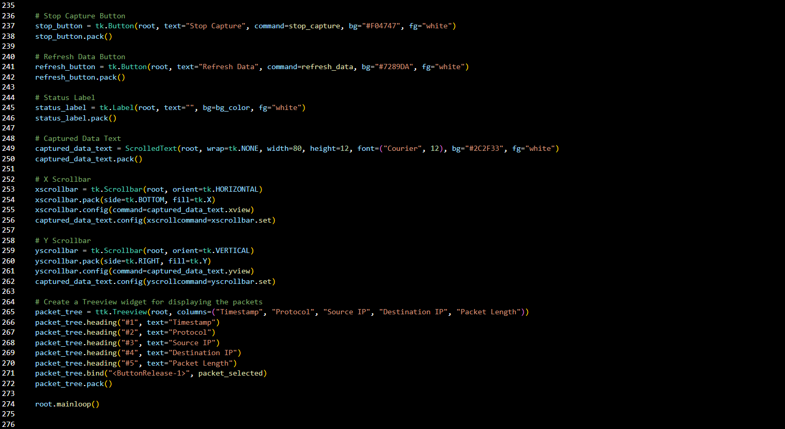

Slide 38
Testing
1. *Testing Objectives:*
- Our testing objectives were to ensure the functionality and reliability of the packet capture and analysis tool. We aimed to verify real-time packet capture, GUI usability, data presentation, IP address lookups, error handling, and resource performance.
2. *Testing Types:*
- We conducted the following types of testing:
- Unit Testing
- Integration Testing
- Functional Testing
- System Testing
3. *Testing Tools:*
- For testing, we used the following tools and libraries:
- **Unit Testing:** Python's `unittest` library.
- **Integration Testing:** Integrated into unit testing.
- **Functional Testing:** Manual testing of the GUI.
- **System Testing:** Manual testing of the entire system, including external resources like the GeoIP database.
4. *Testing Process:*
- **Unit Testing:** Individual functions and components were tested in isolation, covering various scenarios.
- **Integration Testing:** Ensured that different components worked together seamlessly, part of unit testing.
- **Functional Testing:** Manually interacted with the GUI to validate user interactions and responsiveness.
- **System Testing:** Conducted the full system testing, including real-time packet capture, GeoIP lookups, and error handling.

Slide 39
Testing
5. *Test Cases:*
- Some important test cases included:
- Verifying real-time packet capture.
- Testing the responsiveness and usability of the GUI.
- Ensuring accurate IP address lookups using the GeoIP database.
- Evaluating the code's error handling and performance during prolonged capture.
6. *Test Results:*
- Our testing indicated that the code effectively captures packets in real-time, and the GUI is user-friendly.
- IP address lookups using the GeoIP database were accurate.
- Error handling worked as expected, and the code performed well during prolonged capture.
- Limitations and issues were identified (e.g., Windows dependency, resource usage).
7. *Bugs and Issues:*
- We encountered no major bugs, but we identified limitations, such as Windows dependency and resource usage and some minor errors like indentations and uninstalled libraries .
8. *Testing Coverage:*
- We achieved comprehensive coverage in unit and integration testing.
- Limitations existed due to manual functional and system testing, which is challenging to quantify.
9. *Testing Metrics:*
- No specific testing metrics (e.g., code coverage percentage) were used due to the project's nature.
10. *Acknowledgments:*
- We acknowledge the use of external libraries and tools such as pyshark, tkinter, tabulate, and geoip2.

Slide 40
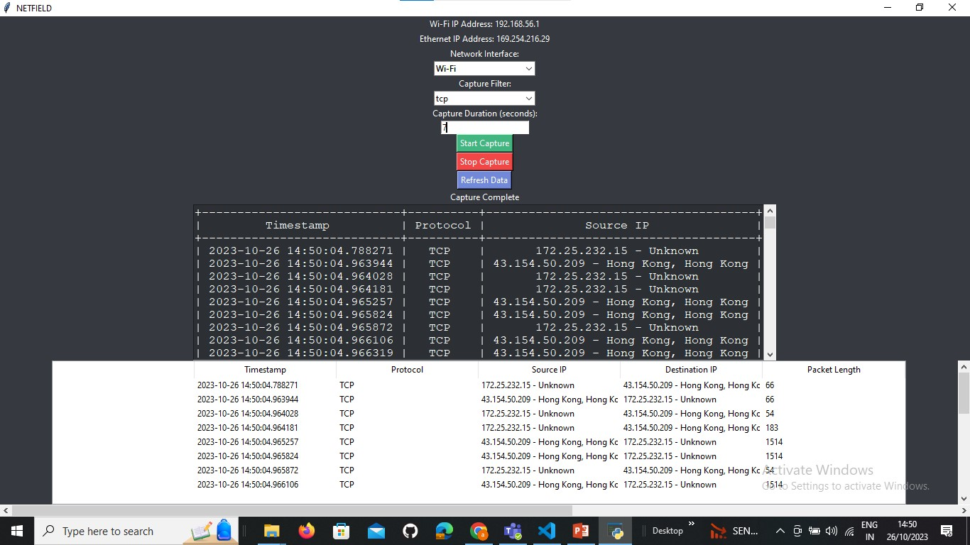
Result and Discussion
So , after giving the input of Network Interface (Wi-Fi , Local Area Connection , Bluetooth Network Connection ) , Capture Filter (it is the protocol of network like tcp , udp , icmp ) and time limit/Capture Duration i.e. total time required to capture all the packets .
We get the output with timestamp (the time at which the packet was captured) , protocol , source IP and destination IP with location and the packet length of the captured packet .
In future , we can add more features in the netfield project including various factors related to network security , detection of harmful packets and many more .
If there is any suspicious network packet then we can also track the network packet’s IP to its location .

Slide 41
Conclusion
The presented code represents a sophisticated and feature-rich network packet capture and analysis tool, designed as a project for various networking and monitoring tasks. This project combines several powerful Python modules and technologies to offer a comprehensive solution for network security .
This project, built using Python and various libraries, addresses the need for network monitoring, packet analysis, and geographic information retrieval. It stands out as a valuable resource in the realm of network management and security .
It cover ups ->
Packet Capture and Analysis: The project leverages the pyshark library to capture network packets in real-time. The analyze_packet function extracts essential information from each packet, including the timestamp, protocol, source and destination IP addresses, and packet length.
Geographic Location Lookup: The inclusion of the geoip2 library allows the tool to perform geographic location lookups for IP addresses. This feature adds depth to network analysis, aiding in understanding the geographical origins of network traffic.
User-Friendly GUI: The graphical user interface (GUI) developed with tkinter offers an intuitive and interactive platform for users to control and monitor network activities. The GUI enables users to start and stop packet capture, select and inspect specific packets, and refresh displayed data.

Slide 42
Conclusion
We would also like to order some limitations of our code ->
Windows Dependency: The code includes Windows file paths and may not work as-is on other operating systems. Adapting it to work on Linux or macOS may require adjustments.
GeoIP Database Updates: The code uses a local GeoIP database for IP address lookups. The database may become outdated over time, and updating it manually is necessary for accurate geographical information.
Dependent on External Libraries: The code relies on external libraries (e.g., pyshark, tkinter, tabulate, geoip2) and their continued support and updates. Changes or deprecation of these libraries can affect the functionality of the code.
Large Packets problem: Handling a large number of packets per second could lead to performance issues.

Slide 43
Thanks

